Slide 1


Automotive Leadership Development Initiative
Leadership Competencies 101 I Draft Roll-Out Plan
Awareness I Knowledge I Cascade

Slide 2


8 LEADERSHIP COMPETENCIES
FOR SUCCESS
Customer Centricity
Commercial Drive
Works to delight internal and external customers with exceptional service and products, acting as a trusted advisor.
An entrepreneurial mindset; recognize and seize opportunities; take measured risk into account. Focus on initiatives that drive business advancement.
Commercial
Drive
Customer Centricity
Customer centricity
Future Proofing
Goal Driven
Demonstrate an unquestionable willingness to learn everyday, un-learn old approaches, and partner with others to assist them in doing the same.
Results focused, delivering stretching outcomes both as an individual and through teams, with no fear of failure, showing enthusiasm and self-motivation to perform.
We value Respect
Goal Driven
Future Proofing
We value Integrity
We value Collaboration
Change Agile
Managing Complexity
Anticipate and lead change: adapt actions, accordingly, demonstrate tolerance for ambiguity; have a comfort with uncertainty. Shows flexibility in adjusting own views and objectives in order to achieve a shared goal.
Change Agile
We value Excellence
Change Agile
Confident managing the various challenges that our increasingly complex workplace and roles demand: global, digital, competitor, consumer, employees.
Managing Complexity
Managing Complexity
Developing talents
Influence
& Challenge
Engaging Leadership
Influence & Challenge
Engaging Leadership
Create positive momentum by persuading the organization, demonstrating personal courage, and an ability to durably align different opinions.
Inspire people through a compelling vision fueled by a culture of support, enablement and empathy. Building a safe environment for employees to be at their best, feel included and valued.

Slide 3









Leadership Competencies 101 Roll-Out: Summary
117K AED
50-55
Phase 1 & 2
Mar-July
Target Timeline 2024
UAE + International
Estimate Budget for approval
Estimate no. of Sessions to be conducted
Phase 1: Band H-L
(2024)
Phase 2: Band G (2025)
Scope of Delivery
510
3 Hours
Hybrid
100%
Success Measure
Post Session Feedback/Knowledge Transfer Survey
Target Audience
Bands H-L 2024
Duration of the workshop using gamification (boardgame)
Delivery Mode
27% External
73% Internal
Attendance KPI Bands I-L = 100%
Bands H = 80%
Awareness I Knowledge I Cascade

Slide 4
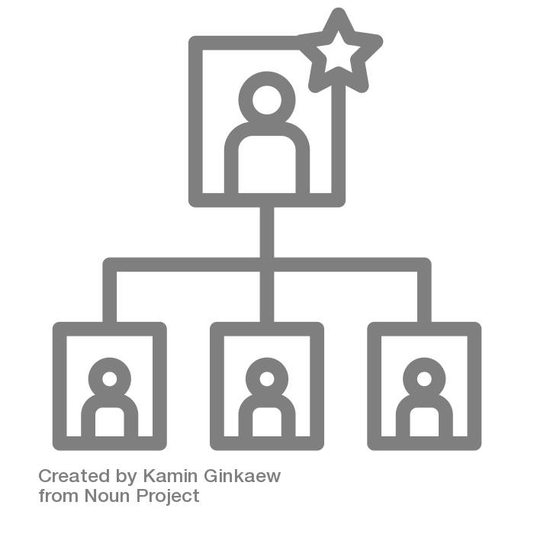


Leadership Competencies 101 Workshop -
Target Audience (UAE + International)
2024 Master KPI: 100% Attendance (Bands I-L)
Count= +/- 172
Count= +/- 338
Count= +/- 588
Cohort 2
Bands H
Cohort 3
Bands G
Cohort 1
Bands I,J,K,L
Phase 1: 2024
Phase 2: 2025
Band | I | J | K | L | H
Count | 108 | 49 | 14 | 1 | 338
Band | G
Count | 588
Awareness I Knowledge I Cascade
Cohort count based on the Jan,2024 census

Slide 5
Target Audience Count – By Country | For Phase 1: 2024
Qatar
Audience: 13
2024 Master KPI: 100% Attendance (Bands I-L)
KSA
Audience :9
UAE
Audience:361
Egypt
Audience: 31
Pakistan
Audience:46
Country | Cohort 1 |  |  |  | Total | Cohort 2 | Grand Total
Country | I | J | K | L | Total | H | Total
UAE | 72 | 41 | 12 | 1 | 126 | 235 | 361
KSA | 2 |  |  |  | 2 | 7 | 9
Oman | 1 | 1 |  |  | 2 | 6 | 8
Egypt | 5 | 1 | 1 |  | 7 | 24 | 31
Kenya | 5 |  |  |  | 5 | 12 | 17
Pakistan | 12 | 5 |  |  | 17 | 29 | 46
Sri Lanka | 3 | 2 |  |  | 5 | 12 | 17
Total | 104 | 50 | 13 | 1 | 172 | 338 | 510
 |  |  |  |  | Cohort 1 | Cohort 2
Oman
Audience:8
Sri Lanka
Audience: 17
Kenya
Audience: 17
Awareness I Knowledge I Cascade

Slide 6






LC 101 Roll-Out Plan (UAE/International) – Example/Draft
Countries | Cohort | Band(s) | Mode | # Pax | # Sessions | Targeted Timelines
 |  |  |  |  |  | Mar | Apr | May | Jun | Jul
UAE | 1 | I,J,K,L |  | 126 | 13
 | 2 | H |  | 235 | 22
KSA | Mix | I,J,K,L,H |  | 9 | 1
Pakistan | 1 | I,J,K,L |  | 17 | 1
 | 2 | H |  | 29 | 3
Egypt | 1 | I,J,K,L |  | 7 | 1
 | 2 | H |  | 24 | 2
Ramadan
April light due to Ramadan/Eid Break
The countries wherein single cohort doesn’t meet minimum participant requirement have include Band H employees
Workshop Duration: 3 Hours
15% buffer for potential drop-outs
External Partner
Estimate no. of
sessions-15
Internal
Est. no. of session-
40-45
50-55

Slide 7





LC 101 Roll-Out Plan (UAE/International) – Example Draft
Countries | Cohort | Band | Mode | # Pax | # Sessions | Targeted Timelines
 |  |  |  |  |  | Mar | Apr | May | Jun | Jul
Sri Lanka | Mix | I,J,H |  | 17 | 1
Oman | Mix | I,J,K,L,H |  | 8 | 1
Qatar | Mix | I,J,K,L,H |  | 13 | 1
Kenya | 1 | I,J,K,L |  | 5 | 1
 | 2 | H |  | 12 | 1
Ramadan
April light due to Ramadan/Eid Break
The countries wherein single cohort doesn’t meet minimum participant requirement have include Band H employees
Workshop Duration: 3 Hours
15% buffer for potential drop-outs
External Partner
Estimate no. of sessions-
10- 15
Internal
Est. no. of session-
40-45
50-55

Slide 8



Awareness I Knowledge I Cascade
LC 101 – Budget Breakdown
Kit Development
+ Pilot
(Executive Session)
Train The Trainer
Delivery Kit Cost
(4 Kits)
Sessions by Ex. Partner
AED 22,000
AED 11,000
AED 12,000
(3000*4)
AED 115,000
^{(7000*15)}
01
02
03
04
Approved
Additional Budget for Approval = AED 117,000
(variation for existing approved PO)

Slide 9
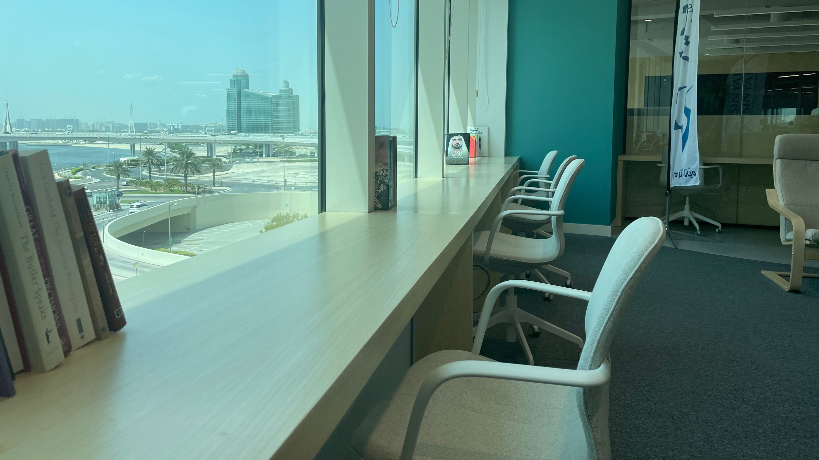
Leadership Competencies 101
Communication & Launch Plan

Slide 10
LC 101 Communication Plan | Automotive Division (Draft)
Phase | Why | Frequency | When | What | How | By Who | To Who | Support
Pre-Launch | Remind post Leadership Day | Once | March 12/13th | Email Template | Email | Amr/Maha | Exec Board Session Attendees
Pilot Launch | Post Exec Session Delivery | Once | March 19th | President Comms | Email | Paul Willis | Bands I-K | Script to be provided
Launch | Announce | Once | March 22nd | Follow up communication mail after Presidents | Email | MDs | Target Audience per Business | Standard template customized per business
Roll-Out | Announce Country Sessions | Once | TBC | Country Level Comms by MDs | Email | Country MDs | Country Bands H-K | A standard template customized for each country
Roll-Out | Build Momentum | Ongoing | TBC | Video collage of select Execs/MDs | Video | HR Comms | Auto Bands H-K | Script & Shooting in collab with Int. Comms
Roll-Out | Build Momentum | Once/Twice | TBC | Testimonials of participants | Emails/ Video | AATC | Auto Bands H-K | Script & Shooting in collab with Int. Comms
Roll-Out | Remind | Ongoing | TBC | Reminder mails | Email | AATC | Auto Bands H-K | Standard reminder template

Slide 11
Thank You!

